Slide 1



IOT-ENABLED SMART WASTE COLLECTION SYSTEM WITH COMMUNITY SHARING AND REAL-TIME ROUTE OPTIMIZATION
RAKK RANASINGHE (D/BIT/22/0039)
Supervised By: Mr. RPS Kathriarachchi

Slide 2
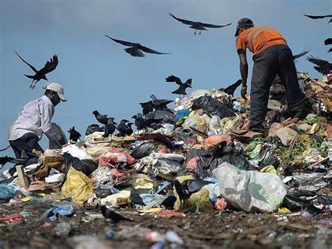
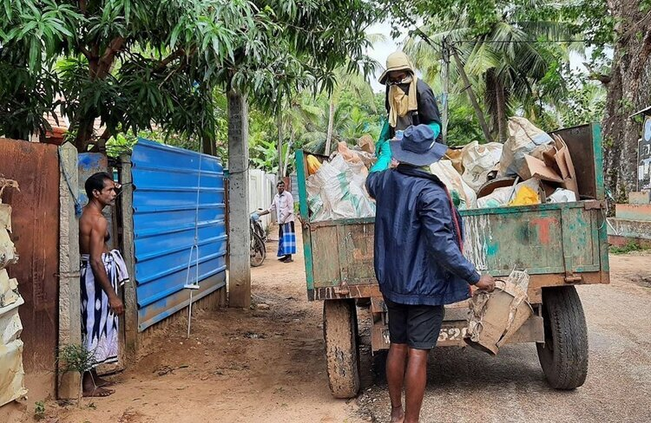
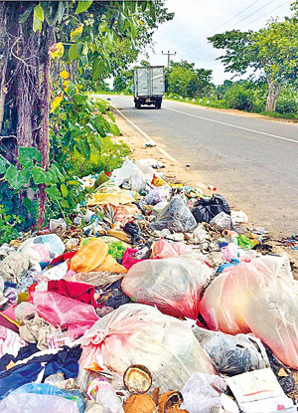
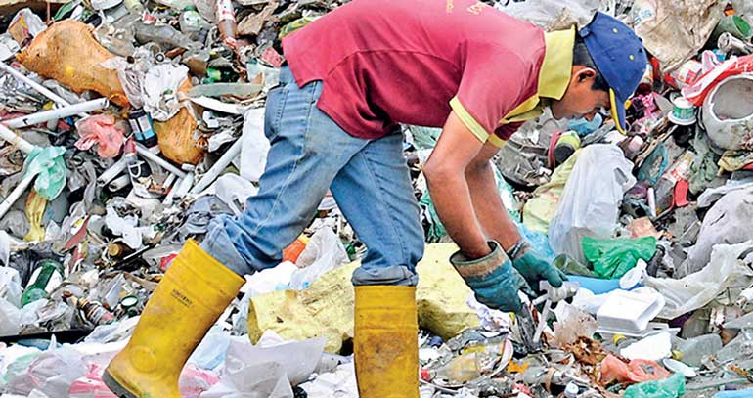
Familiar
with this ??

Slide 3


03
INTRODUCTION
Efficient waste collection is essential for cleanliness, sustainability, and community well-being. Challenges such as delays, missed locations, and inefficiencies can strain resources and increase costs. By incorporating real-time tracking, route optimization, and community sharing of reusable items, this system encourages timely pickups, reduces waste, and fosters collaboration among citizens to promote a cleaner, greener environment

Slide 4

04
PROBLEM DOMAIN
Current waste collection systems face significant challenges that hinder efficiency and sustainability
Inefficient Collection: Delays, missed pickups, and unoptimized routes increase costs
No Real-Time Tracking: Limits monitoring of bins and vehicles
Reusable Waste Loss: Lack of community sharing discards reusable items
Environmental Risks: Accumulated waste causes pollution and health hazards
Low Public Involvement: Lack of tools for citizen participation

Slide 5
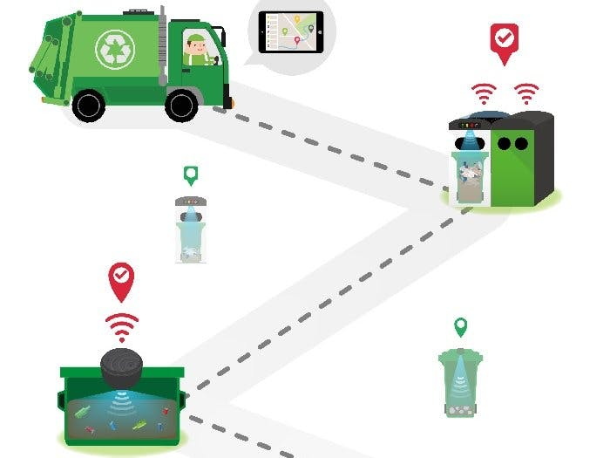
05
PROPOSED SOLUTION
To tackle the challenges in waste collection, a comprehensive solution is proposed, integrating advanced technologies and community-driven initiatives to enhance efficiency, sustainability, and public engagement
IoT-enabled bins for real-time monitoring
AI-based route optimization
Mobile/web apps for tracking and reporting
Community sharing to reduce waste
Real-time truck tracking and data analytics

Slide 6

06
METHODOLOGY
Requirement Gathering: Analyze waste collection processes, challenges, and user needs with stakeholders
System Design: Use microservices for modular functionalities like tracking, notifications, and reporting
Development: Follow Agile methodology for incremental feature implementation and frequent testing
Testing: Perform user acceptance testing to ensure usability and effectiveness
Deployment and Feedback: Launch the system, collect feedback, and improve features iteratively

Slide 7

07
FUNCTIONAL REQUIREMENTS
Waste Collection Monitoring: IoT bins send real-time data; residents schedule pickups
Community Sharing: Share reusable items via the app
Immediate Pickups: Residents request urgent pickups; drivers get real-time alerts
Route Optimization & Tracking: Generates and updates efficient routes; displays bin locations and optimized paths
Alerts & Notifications: Real-time updates for users and drivers
Reports & Analytics: Insights on waste trends and system performance
User Management: Manage accounts, roles, and user activity

Slide 8
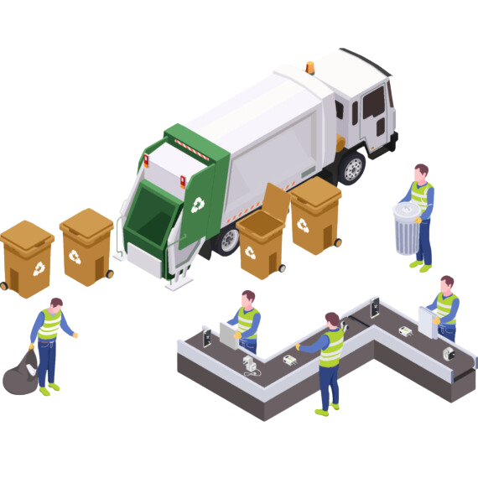
08
NON -FUNCTIONAL REQUIREMENTS
Scalability: Support growth in users, IoT devices, and trucks
Reliability: Ensure continuous uptime and system stability
Performance: Deliver real-time updates and notifications efficiently
Security: Protect data with encryption and controlled access
User-Friendly: Provide intuitive and accessible interfaces for all users
Profit Projections

Slide 9
09
AIMS & OBJECTIVES
Objectives:
Track waste bins and trucks in real-time
Optimize collection routes using AI
Provide mobile and web apps for user notifications
Enable on-demand waste pickup
Allow users to share reusable waste items
Guide users on proper waste segregation
Let citizens report waste-related issues
Aim:
To develop a Smart Waste Collection System that improves efficiency, reduces costs, and enhances user engagement

Slide 10












10
TECHNOLOGIES
Prototyping: Figma
Hardware (IoT Bin): ESP32, GPS (NEO-6M), LoRa/BLE, LEDs
Front-end Development: React, Flutter
Back-end Development: Node.js, Express.js, Google Maps API
Databases: Firebase
Communication: ESP-NOW, MQTT, HTTP/HTTPS
Version Control: Git, GitHub

Slide 11
11
LITERATURE REVIEW - SUMMARY
Focus | Key Findings | Reference
IoT | IoT-enabled real-time monitoring reduced overflow risks, improved efficiency, and saved resources | Zeb et al, Haque et al., Folianto et al.
Route Optimization | Optimized collection routes, minimized carbon emissions, and reduced fuel consumption | Lozano et al., Mukherjee et al.
Cost Efficiency | Enhanced cost efficiency, reduced operational costs, and saved energy | Mukherjee et al., Lozano et al.
AI & Machine Learning | Improved prediction accuracy and reduced waste transport inefficiencies through AI algorithms | Rutqvist et al.
Community Engagement | Encouraged community participation, improved recycling rates, and supported 3R principles | Abd Wahab et al.

Slide 12
12
Focus | Key Findings | Reference
Cost Reduction & Sustainability | Reduced cleanup costs by 58 million USD and aligned with SDGs | Mager et al.
Waste Bin Monitoring | Improved waste bin filling forecasts, reduced overflow situations, and enabled efficient resource use | Morais et al.
Recycling & User Interface | Addressed recycling inefficiencies and hazardous material handling through tailored user interfaces | Donny et al.
Sustainability | Enhanced traceability and promoted sustainability through smart waste management solutions | Fatimah et al.
Energy Conversion | Highlighted energy conversion methods and cost-effective waste management strategies | Mukherjee et al.

Slide 13
THANK YOU !

